Slide 1

HTML, CSS and JavaScript revision

Slide 2
HTML5 page (Hypertext Markup Language)
Information to the browser to ensure web page is parsed the same way by different web browsers
<!DOCTYPE html>
<html lang="en">
<head>
<meta charset="UTF-8">
<meta name="viewport" content="width=device-width, initial-scale=1.0">
<title>Document</title>
</head>
<body>
</body>
</html>
<script src="qaScript.js"></script>
<link href="qaStyle.css" rel="stylesheet" />
Best display for the user’s viewport
Best in a separate files

Slide 3
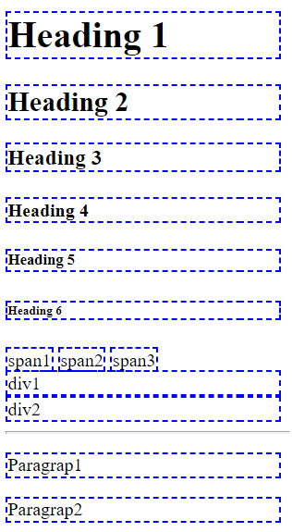
Revision: Tags for displaying data
Displaying text and
<span>
<h1,2,3,4,5,6>
Container
<div>
<p>
Breaks and lines
<hr>
<bra>
Categories (see CSS display property)
Block
Inline
Block-inline
<h1>Heading 1</h1>
<h2>Heading 2</h2>
<h3>Heading 3</h3>
<h4>Heading 4</h4>
<h5>Heading 5</h5>
<h6>Heading 6</h6>
<span>span1</span>
<span>span2</span>
<span>span3</span>
<br />
<div>div1</div>
<div>div2</div>
<hr />
<p>Paragrap1</p>
<p>Paragrap2</p>

Slide 4
Revision: Basic formatting
<small>AAA</small>
<strong>AAA</strong>
<b>AAA</b> <i>AAA</i> <u>AAA</u>
H<sub>2</sub>O
X<sup>2</sup>
<del> <ins> and <mark>
H₂O X²
<del>delete this </del>text. This text is <ins>insert</ins> here!Mark my <mark>word</mark>!</p>

Slide 5
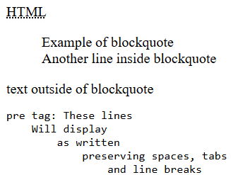
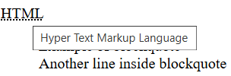
More tags for displaying data
<abbr title="Hyper Text Markup Language">HTML</abbr>
<blockquote>
Example of blockquote<br />
Another line inside blockquote
</blockquote>
<div>text outside of blockquote</div>
<pre>
pre tag: These lines
Will display
as written
preserving spaces, tabs
and line breaks

Slide 6

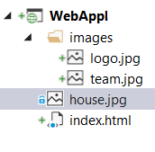
Relative and absolute path
Image in the same folder as the html page:
<img src="house.jpg" alt="Image of house" />
Image in the images sub-folder where the html page is located:
<img src="images/team.jpg" alt="QA team picture" />
Image in root folder:
<img src="/images/logo.jpg" alt="QA logo" />
Image from a URL:
<img src="http://qa.somee.com/html/slides/team.jpg" alt="QA team picture" />

Slide 7


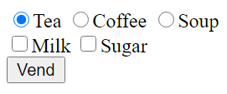
<form>
Server-side code
<html>
<head>
</head>
<body>
<form method="get" action="serve.aspx" >
<div>
<input type="radio" name="drink" value="t" checked />Tea
<input type="radio" name="drink" value="c" />Coffee
<input type="radio" name="drink" value="s" />Soup
</div>
<div>
<input type="checkbox" name="chkMilk" value="y" />Milk
<input type="checkbox" name="chkSugar" value="y" />Sugar
</div>
<input type="submit" value="Vend" />
</form>
</body>
</html>
post
view

Slide 8
Inputting and selecting data
<input type="___" />
attributes
min, max , maxlength
autocomplete off/on
spellcheck true/false
placeholder
disabled
text number email URL password date datetime time day month week submit reset File range
<input type="number" min="1 max="50" placeholder="type a number (1-50)" />
<input type="text" maxlength="10" placeholder="type password (1-10)" required/>
<input type="text" placeholder="type your name" spellcheck="false" autocomplete="off"/>
view

Slide 9
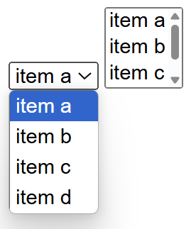
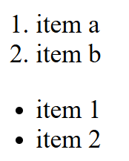
Lists
Dropdown ListBox and ListBox:
Ordered and unordered lists
<select>
<option>item a</option>
<option>item b</option>
<option>item c</option>
<option>item d</option>
</select>
<select size="3">
<option>item a</option>
<option>item b</option>
<option>item c</option>
<option>item d</option>
</select>
<ol>
<li>item 1</li>
<li>item 2</li>
</ol>
<ul>
<li>item 1</li>
<li>item 2</li>
</ul>

Slide 10
Other forms of lists
Description list element
<dl>
<dt>Programming Courses</dt>
<dd>Java SE programming II</dd>
<dd>C# development</dd>
<dt>Web Development Fundamentals</dt>
<dd>Level 3 web application</dd>
<dd>Responsive web application</dd>
</dl>
<details>
<summary>details tag</summary>
<ol>
<li>Audio and video</a></li>
<li>Camera</li>
<li>Files</a></li>
<li>Geolocation</li>
</ol>
</details>
<input type="text" list="foodOptions" />
<datalist id="foodOptions">
<option value="Meat">
<option value="Vegetarian">
<option value="Semi-vegetarian">
<option value="Low-carbohydrate diet">
</datalist>
view

Slide 11
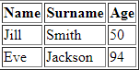
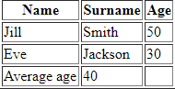
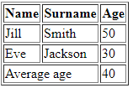
Table
For displaying tabular data or basic positioning other controls
<table border="1">
<tr>
<th>Name</th>
<th>Surname</th>
<th>Age</th>
</tr>
<tr>
<td>Jill</td>
<td>Smith</td>
<td>50</td>
</tr>
<tr>
<td>Eve</td>
<td>Jackson</td>
<td>94</td>
</tr>
</table>
<table border="1">
<thead>
<tr>
<th>Name</th>
<th>Surname</th>
<th>Age</th>
</tr>
</thead>
<tr>
<td>Jill</td>
<td>Smith</td>
<td>50</td>
</tr>
<tr>
<td>Eve</td>
<td>Jackson</td>
<td>30</td>
</tr>
<tfoot>
<tr>
<td>Average age</td>
<td>40</td>
<td></td>
</tr>
</tfoot>
</table>
<thead> and <tfoot> may be used for css
<tfoot>
<tr>
<td colspan="2">Average age</td>
<td>40</td>
</tr>
</tfoot>
view

Slide 12

CSS
Measurement units
DOM selection
Changing attributes
Positioning elements bloock, inline and inline-block
Enhancing the look using CSS3
Media queries

Slide 13
CSS – Selectors basic
See also
<style>
#div1 { background-color:red; }
.qaClass { background-color:green; }
p.qaClass { border: 3px dashed gray; }
div[company=QA] { background-color:blue; }
</style>
<body>
<div id="div1"> Hello </div>
<div class="qaClass"> World </div>
<p class="qaClass"> Paragraph with qaClass </p>
<div company="QA"> QA Training </div>
</body>

Slide 14
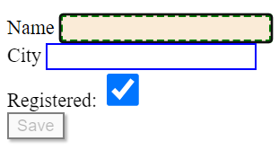
CSS – Selectors – by state
<body>
Name <input type="text" />
City <input type="text" />
Registered: <input type="checkbox" />
<button disabled>Save</button>
</body>
<style>
:checked {
height: 2em;
width: 2em;
}
:disabled {
border: 2px solid gray;
box-shadow: 2px 2px 2px;
}
:enabled {
border: 2px solid blue;
}
:focus {
border: 3px dashed green;
background-color: antiquewhite;
}
</style>
:checked
:disabled
:enabled
:focus
view

Slide 15
CSS – Selection by validation
input:in-range
input:out-of-range
See also:
input:invalid
input:valid
<html>
<head>
<style>
input:in-range {
border: 2px solid green;
}
input:out-of-range {
border: 2px solid red;
}
</style>
</head>
<body>
<input type="number" min="5" max="10" value="7">
</body>
</html>
Demo

Slide 16
CSS - positioning elements
Demo
Block, inline, inline-block
display
float, clear
position
static, absolute, sticky …
overflow
Demo
Demo

Slide 17
JavaScript
Revision of the language
DOM selection
DOM manipulation
Dynamic Events

Slide 18
Language basics – Selection and iteration
if (x > 5) {
console.log('x is bigger than 5');
}
else if (x == 5) {
console.log('x is equal to 5');
}
else {
console.log('x is less than 5');
}
let x = 5;
while (x > 0) {
console.log(x);
x--;
}
for (let i = 1; i < 10; i++) {
console.log(i);
}

Slide 19
forEach and Arrays
let names = ['Mike', 'Bob', 'Linda'];
names.forEach(n => {
console.log(n)
});
names.push('Sasha');
console.log(names);
['Mike', 'Bob', 'Linda', 'Sasha'];

Slide 20
Language basics – Methods
function add(a, b) {
return a + b;
}
3 ways to define a function
const add = function (a, b) {
return a + b;
}
let result = add(1, 2);
console.log(result);
const add = (a, b) => {
return a + b;
}

Slide 21
Selection of DOM elements
<div id="divInfo">.....</div>
<input type="radio" name="drink" />
<input type="radio" name="drink" />
<input type="radio" name="drink" />
<div class="redBorder">.....</div>
<div class="redBorder">.....</div>
let info = document.getElementById('divInfo');
let drinks = document.getElementsByName('drink');
let divs = document.getElementsByClassName('redBorder');
info.innerHTML = "QA"; drinks[0].checked = true;
divs[0].innerHTML = "QA";
Using querySelector
let info = document.querySelector('#divInfo');
let drinks = document.querySelectorAll('[name=drink]');
let divs = document.querySelectorAll('.redBorder');

Slide 22
Manipulating DOM elements – creating new elements
<ol id="students"></ol>
<script>
let ol = document.getElementById('students');
let names = ['Mike', 'Bob', 'Linda'];
names.forEach(name => {
let li = document.createElement('li');
li.innerHTML = name;
ol.appendChild(li);
});
</script>
Mike
Bob
Linda
Demo

Slide 23
JavaScript – Adding Events
<div id="divNames"></div>
<div id="lblName"></div>
<script>
let names = ['Jonathan', 'Christopher', 'Sean', 'Sasha', 'Kimberly', 'Lorenzo'];
let divNames = document.getElementById('divNames');
let lblName = document.getElementById('lblName');
let ol = document.createElement("ol");
divNames.appendChild(ol);
for (let i = 0; i < names.length; i++) {
let li = document.createElement("li");
li.innerHTML = names[i];
ol.appendChild(li);
li.addEventListener('click', (e) => {
lblName.innerHTML = e.target.innerHTML;
});
}
</script>
Demo`

Slide 24
CSS – using JavaScript
let div1 = document.getElementById('div1');
div1.style.border = "1px solid red";
div1.className = "myStyle";
div1.classList.add("myStyle");
1
2
<style>
.myStyle {
width: 100%;
padding: 25px;
color: white;
}
</style>
3
var css = {
width: '150px',
height: '50px',
padding: '5px'
};
css.border = '2px dashed red';
Object.assign(div1.style, css);
4

Slide 25
Variable declaration – global, const
function scopeDemo() {
price = 100; // becomes global when the function is called
const VAT = 0.2; // local scope and value cannot change
// … some code
VAT = 0.15; uncaught TypeError: Assignment to constant variable.
}
scopeDemo();
console.log(price); // 100
console.log(VAT); Uncaught ReferenceError: VAT is not defined

Slide 26
Variable declaration – var, let
function scopeDemo() {
var p = 10; // function scope
let q = 2; // local scope (see for loop)
for (let i = 0; i < 5; i++) { // scope of i is within the for loop
var total = q * p + i; // following lines have access to total
}
console.log(total);
console.log(i); Uncaught ReferenceError: i is not defined
}
scopeDemo();
console.log(p); Uncaught ReferenceError: p is not defined
console.log(q); Uncaught ReferenceError: q is not defined
Recommendations
1- use const if value should not be change
2- use let to limit scope
3- do not use global variables!

Slide 27
OO in JavaScript
class Student {
constructor(name, age, stream) {
this.name = name;
this.age = age;
this.stream = stream;
}
getInfo() {
return `Name:${this.name}, Age:${this.age}, Stream:${this.stream}`;
}
}
let stu1 = new Student('Mike', 21, 'Software');
console.log(stu1.getInfo());
Name:Mike, Age:21, Stream:Software
stu1.company = 'QA';
console.log(stu1.company);
QA
Demo

Slide 28
JSON - stringify
let stu1 = new Student('Mike', 21, 'Software');
console.log(JSON.stringify(stu1));
{"name":"Mike","age":21,"stream":"Software"}
let stu2 = new Student('Linda', 19, 'Web');
let stu3 = new Student('Bob', 28, 'Testing');
let students = [stu1, stu2, stu3];
console.log(JSON.stringify(students));
[{"name":"Mike","age":21,"stream":"Software"},{"name":"Linda","age":19,"stream":"Web"},{"name":"Bob","age":28,"stream":"Testing"}]

Slide 29
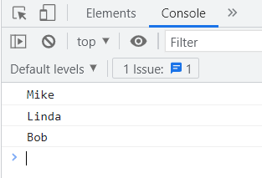
JSON - parse
let data = `[{"name":"Mike","age":21,"stream":"Software"},{"name":"Linda","age":19,"stream":"Web"},{"name":"Bob","age":28,"stream":"Testing"}]`;
let students = JSON.parse(data);
students.forEach(stu => console.log(stu.name));

